Slide 1
Unit 3
P.RAJESH
Dept of ECE

Slide 2
Design choices
Every computer in an Ethernet network must have an Ethernet controller.
Components :
Requirements :- 10 Base T & 10 Base Tx systems.
IEEE 802.3 standard requires an isolation transformer that along function as lowpass filter between controller and network RJ-45 connector
The program code includes support for ethernet TCP/IP and other Inputs.

Slide 3
1. Rabbit Semiconductor RCM3200
At a glance: A fast Z80-derivative CPU with plenty of I/O, low EMI, and a complete development system, including a C compiler.
Ethernet support: 10BASE-T and 100BASE-TX.
Source: Rabbit Semiconductor (www.rabbitsemiconductor.com).
Hardware: The RCM3200 RabbitCore C-programmable Module with Ethernet is a circuit board that contains Rabbit Semiconductor’s Rabbit 3000 microprocessor, which is a much improved and enhanced derivative of ZiLOG, Inc.’s venerable Z80 microprocessor.
The Rabbit 3000 microprocessor has seven 8-bit I/O ports.
Many of the bits can have special functions, including six serial ports for asynchronous and synchronous communications and Infrared Data Association (IrDA) protocols,
A bidirectional parallel port, two input-capture channels,
Four pulse-width-modulation (PWM) outputs,
Two quadrature decoder units with inputs for optical incremental encoder modules.

Slide 4
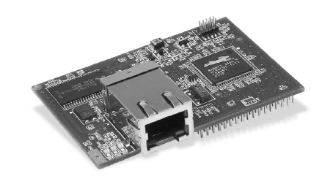

Slide 5
In addition to the I/O ports, there is an external memory bus with 8 data bits and 20 address lines.
The power supply can range from +3.6V to as low as +1.8V.
A counter that functions as a real-time clock has a separate power pin to make it easy to provide battery backup.
The chip is available in a 128-pin LQFP (low profile quad flat pack) or 128-ball TFBGA (thin-profile fine-pitch ball grid array) package.

Slide 6
Features :
The Rabbit 3000 also has several features for applications that must conserve power.
Lowering the supply voltage can reduce power consumption by 75 %.
Slowing the clock reduces power consumption as well.
The CPU can switch between a fast clock (up to 54 Megahertz) and a second clock that can run at 32 kilohertz.
The CPU can use the slow clock while waiting for a specified time to elapse or an event to occur, then switch to the faster clock when processing power is needed.

Slide 7
The RCM3200 module contains a Rabbit 3000 clocked at 44.2 MHZ
  There are 512 kilobytes of Flash memory for storing programs
  512 kilobytes of fast RAM for loading code for execution
  256 kilobytes of RAM for storing data.
One of the serial ports uses a special programming cable to load firmware from a PC into RAM or Flash memory.
The module’s Ethernet controller is an ASIX AS88796 3-in-1 Local Bus Fast Ethernet Controller, which interfaces to the CPU’s external data bus.
The module has an RJ-45 connector for 10BASE-T and 100BASE-TX Ethernet media systems. Two headers on the bottom of the board provide access to the I/O bits and other signals.

Slide 8
Software:- Rabbit Semiconductor’s Dynamic C is a complete environment for writing and editing code.
The compiler also supports in-line assembly code. For networking, Dynamic C includes drivers for the Ethernet controller and libraries that support TCP/IP communications and other networking protocols.
The libraries provide support for an HTTP server, an FTP client and server, and sending and receiving e-mail with SMTP and POP3. A
file system supports storing information in files in Flash memory or battery-backed RAM.
Additional library modules are available, including a module that implements the open-source, real-time MicroC/OS-II operating system.

Slide 9
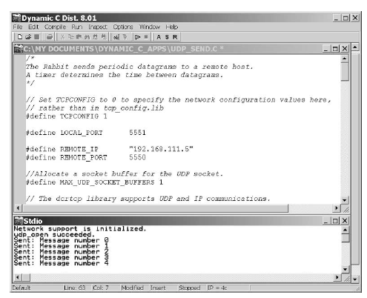

Slide 10
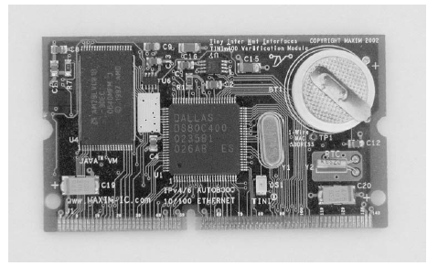
2. Dallas Semiconductor DSTINIm400 (TINI)

Slide 11
At a Glance: A fast microcontroller with an enhanced 8051 architecture, plenty of I/O, an operating system, and a Java virtual machine (JVM).
Ethernet support: 10BASE-T, 100BASE-TX
Typical Uses: applications that need speed, lots of I/O, or a CAN interface.
Source: Dallas Semiconductor (www.dalsemi.com).
Hardware:- TINI stands for Tiny InterNet Interface. Technically, the TINI isn’t a CPU or a circuit board, but a platform that consists of a CPU and related components, support for networking, and a Java runtime environment.
The module’s circuit board contains a Dallas Semiconductor DS80C400 Network Microcontroller,

Slide 12
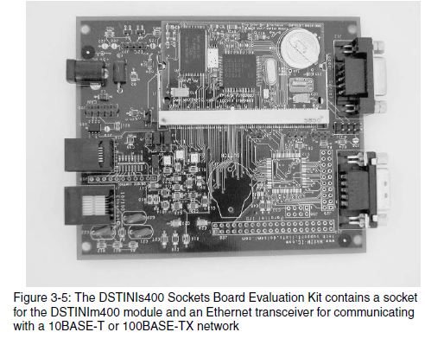

Slide 13
The Software: The TINI Software Developers Kit (SDK), available for free downloading from Dallas Semiconductor’s Web site, includes the TINIOS operating system and a Java Virtual Machine (JVM).
The operating system enables running multiple tasks by scheduling the tasks in time slices.

Slide 14
3.Systronix JStik
At a glance: direct execution of Java byte codes eliminates the need for an interpreter.
Ethernet support: 10BASE-T
Typical use: Applications that use Java and require speed.
Source: Systronix (www.systronix.com).
Hardware: The TINI isn’t the only option for Java programmers. Systronix’s JStik board contains aJ-100 microcontroller from aJile Systems Inc.
The aJ-100’s native execution of Java bytecodes results in very fast per-formance. The chip is based on the JEM processor developed at Rockwell Collins.
The JStik adds a high-speed I/O bus that can operate at bursts of 50 Megabytes per second, two RS-232 ports, and SPI and I2C interfaces.
Software: Systronix provides aJile’s Jem Builder tool and Charade debugger for building, loading, and testing applications. You can use other Java environments and tools with the JStik as well.

Slide 15
4.Netburner MOD5282 Processor Module
At a glance: Fast Ethernet and a fast 32-bit CPU with lots of memory and I/O.
Ethernet support: 10BASE-T and 100BASE-TX
Typical use: Applications that need speed and abundant resources
Source: Netburner, Inc. (www.netburner.com)
Hardware. Netburner’s MOD5282 Processor Module contains Motorola’s 32-bit ColdFire MCF5282 processor.
The MCF5282 supports a subset of the Motorola 68000 CPU’s instruction set. The chip has 512 kilobytes of Flash memory and 64 kilobytes of RAM.
For I/O interfacing, the MCF5282 has three UARTS, a CAN interface, an I2C controller, a queued serial peripheral interface (QSPI) for synchronous serial communications, and an 8-channel, 10-bit analog-to-digital converter.
The MOD5282 includes 8 Megabytes of SRAM and connections for a 16-bit data bus and 16-bit address bus. For networking, the board includes a PHY for 10-Mb/s and 100-Mb/s Ethernet and an RJ-45 connector.
Software: Also included in the Module 5282 Development Kit are software support for Ethernet and Internet protocols, an operating system based on the freeware μC/OS, the freeware GNU C/C++ compiler, a debugger, and configuration utilities.

Slide 16
5. Microchip Technology PICDEM.net Demonstration Board
At a glance: An aid to developing networking applications for Microchip Technology’s PICMicro microcontrollers.
Ethernet support: 10BASE-T
Typical use: Projects that require minimal resources or any PICMicro-based project with an Ethernet interface or support for Internet protocols.
Source: Microchip Technology (www.microchip.com).
Hardware. The PICDEM.net Demonstration Board contains a microcontroller, Ethernet controller, related components, and a breadboarding area.
The microcontroller is a PIC16F877, a member of Microchip Technology’s popular PICMicro family The PIC16F877 has Flash memory that can store 8192 14-bit words, 368 bytes of RAM, and 192 bytes of EEPROM.
There are 33 I/O bits. Many of the bits have alternate functions, including an eight-channel, 10-bit analog-to-digital converter, an asynchronous serial port, a synchronous serial port, and a parallel interface.

Slide 17
Special-Purpose Modules
1. Lantronix Device Server
At a glance: enables any device with an asynchronous serial port to communicate over a network.
Typical use: any device or system that communicates over a serial port and requires network access.
Ethernet support: 10BASE-T, 100BASE-TX
Source: Lantronix, Inc. (www.lantronix.com)
Hardware: Lantronix offers its Device Servers in a variety of packages, including devices in enclosures, circuit boards and chips for incorporating into other devices, and a server squeezed into a slightly extended RJ-45 connector.
Software :- For programming, the DSTni-LX Development kit includes a development board and the Paradigm C++ Professional development toolkit. The USNET TCP/IP software suite and a real-time operating system are also available separately for use in your own hardware. USNET is compatible with Intel 80x86, Motorola 68K, and other microprocessors. Source code is included.

Slide 18
2. Ubicom IP2022 Wireless Network Processor
At a glance: A CPU optimized for networking with software-configurable peripherals and wireless support.
Typical use: Web servers and wireless networking
Ethernet support: 10BASE--T
Source: Ubicom, Inc. (www.ubicom.com)
Hardware:- Ubicom’s IP2022 Wireless Network Processor is a CPU optimized for networking functions.
The chip contains two configurable Serializer/ Deserializer blocks.
Using software modules provided by Ubicom, each block can support Ethernet, USB, a General Purpose Serial Interface (GPSI), a Serial Peripheral Interface (SPI), or a UART. The CPU uses a 120-Megahertz clock obtained from a 4.8-Megahertz crystal.
Software: Project development uses Ubicom’s integrated development environment and GNUPro, a software development suite that includes a C compiler. The suite is built around the open-source GNU standard and is available from Red Hat (www.redhat.com).

Slide 19
Netmedia SitePlayer Ethernet Web Server
At a glance: a very inexpensive module that can serve Web pages and perform UDP communications with a minimum of user programming.
Requires a serial link to a CPU to update Web page data and receive data from clients.
Ethernet support: 10BASE-T

Slide 20
Typical use: Basic monitoring and control tasks.
Source: Netmedia (www.netmedia.com)
Hardware: The main purpose of Netmedia’s SitePlayer is to provide a very low-cost platform for serving Web pages, including pages with dynamic content.
PU over a serial link. The SitePlayer can place data received from the CPU in its Web pages and can send data from a form or a hyperlink on a Web page to the CPU.
The CPU can also use the SitePlayer to send and receive UDP datagrams over a network.
The SitePlayer contains just two chips: a Philips 8051-compatible P89C51 microcontroller and a Realtek RTL8019AS Ethernet controller.
The SitePlayer’s software manual explains the syntax to use in the Definition file.

Slide 21
Ethernet Controller Basics
In an Ethernet-capable embedded system, a CPU manages communications with the Ethernet controller. The minimum requirement for the CPU is a microcontroller with an external 8-bit data bus.
Some of the controllers that have been popular in embedded systems were designed for use on expansion cards for the ISA bus of early PCs.
Related Components
A typical controller requires few additional components. For 10BASE-T and 100BASE-TX systems, the IEEE 802.3 standard requires an isolation transformer that also functions as a low-pass filter between the controller and the network’s RJ-45 connector.

Slide 22
NE2000 Compatibility
To program code for network controllers is NE2000-compatible.
The NE2000 was an early and popular PC network interface card from Novell.
The card contained National Semiconductor’s DP8390 controller. Software for systems that use the ’8390 or a compatible chip has come to be known as NE2000-compatible code.
A major feature of the ’8390 is its set of internal registers. By reading and writing to the registers, a CPU can configure the controller, initiate transmitting of data on the network, and read received network data.
The registers in the ’8390 are arranged in two 16-byte pages.
The CR register is at offset 00h on both pages. Writing to bits 6 and 7 in the CR register selects the current page. Offsets 01h through 0Fh on each page store additional register values. On power-up or reset, program code typically initializes the registers to desired values before Ethernet data transfers begin.

Slide 23
Documentation
Many providers of controller chips have example code for setting up the registers and transferring frames.
newer NE2000-compatible chips. National Semiconductor also has a couple of application notes. Note AN-475: DP8390 Network Interface Controller: An Introductory Guide, describes the processes of sending and receiving data.
Note AN-874: Writing Drivers for the DP8390 NIC Family of Ethernet Controllers, focuses on programming, with example assembly code for a PC.

Slide 24
The ASIX AX88796
An Ethernet controller designed for use in embedded systems is the AX88796 3-in-1 Local Bus Fast Ethernet Controller from ASIX Electonics Corporation. Rabbit Semiconductor uses this controller in its RCM3200 module. The controller supports Ethernet communications at 10 and 100 Mb/s.
The ’88796 is NE2000-compatible. A major difference between the ’88796 and the DP8390 is that the ’88796 has an on-chip 16-kilobyte static RAM (SRAM) buffer for network data. The ’88796 also has separate (not multiplexed) data and address buses and an interface to serial EEPROM.
Connections
the basic connections the RCM3200 module uses for the ’88796. The chip is a 128-pin plastic light quad flat pack (PLQFP). The clock is a 25-Mhz crystal or oscillator. The power supply is +3.3V. Three outputs drive status LEDs.

Slide 25
Ethernet: For twisted-pair networks, the chip can connect through a filter to an RJ-45 jack. The RCM3200 uses a PulseJack module from Pulse Engineering, Inc. The module integrates the RJ-45 connector and filtering circuits in a single package. An on-chip MII enables using an external PHY to connect to other cable types at 10 or 100 Mb/s.
Bus Compatibility: -The CPU0 and CPU1 pins configure the chip for use with one of four bus types that are popular in embedded systems: ISA, Intel 80186, Intel MCS-51 (8051), and Motorola 68000.
SRAM: The controller’s 16-kilobyte SRAM buffer holds packets waiting to transmit on the network and packets received from the network. With an 8-bit data bus, only 8 kilobytes of the SRAM are available.
Addressing: The chip has 10 address inputs, but not all systems need them all. The first five bits (SA0 through SA4) address the controller’s internal registers. Every controller must have these lines connected to the CPU’s address bus. Two of the registers (10h, 11h) are the Data Port, which enables the CPU to access the controller’s 16 kilobytes of SRAM without using additional address lines.

Slide 26
Data. A register bit in the ’88796 selects whether the controller uses 8 or 16 data lines. The data bus for the 68000 mode must be 16 bits, but the other buses can use 8 or 16 bits.
Interrupts: The IRQ interrupt output can request service from the CPU. The polarity of the signal depends on the selected bus type. A CPU that doesn’t support or doesn’t want to use interrupts can poll the interrupt line.
Serial EEPROM Interface: The ’88796 has four pins that can interface to aserial EEPROM with a Microwire interface. The EEPROM can providenon-volatile storage for an Ethernet hardware address and other information.

Slide 27
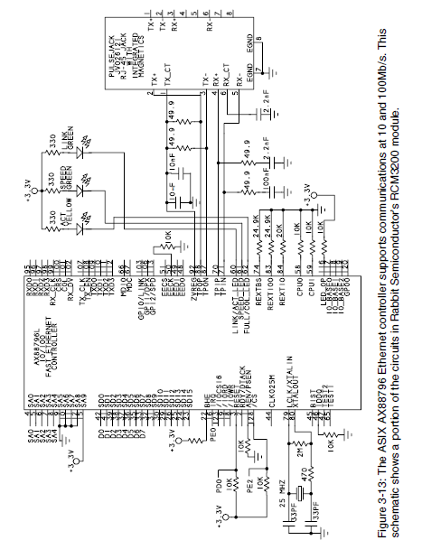

Slide 28
Realtek RTL8019AS
For embedded systems with 10BASE-T support, one of the most popular controllers has been the RTL8019AS Full Duplex Ethernet Controller with Plug and Play Function from Realtek Semiconductor Corp. The ’8019AS is another NE2000-compatible derivative of the DP8390. Like the ASIX ’88796, the ’8019AS has an on-chip 16-kilobyte SRAM and an interface to serial EEPROM.
Connections
for Rabbit Semiconductor’s RCM2100 module. The chip is a 100-pin quad flat pack (QFP). The clock is a 20-Mhz crystal or oscillator. Four outputs can drive status LEDs. The power supply is +5V.
Ethernet: For 10BASE-T networks, the chip can connect through a filter to an RJ-45 jack. The chip also contains an AUI to enable using other 10-Mb/s media systems.

Slide 29
SRAM: The controller’s 16-kilobyte SRAM buffer holds packets waiting to transmit on the network and packets received from the network. When using 8-bit data, only eight kilobytes of the buffer are available.
Addressing: The address bus is 18 bits. The first five bits address the controller’s internal registers. If the controller shares the bus with other chips, it can use additional address lines to select the chip on the bus. The chip allows a choice of 16 PC-compatible base addresses. The IORB and IOWB inputs control the read and write operations.

Slide 30
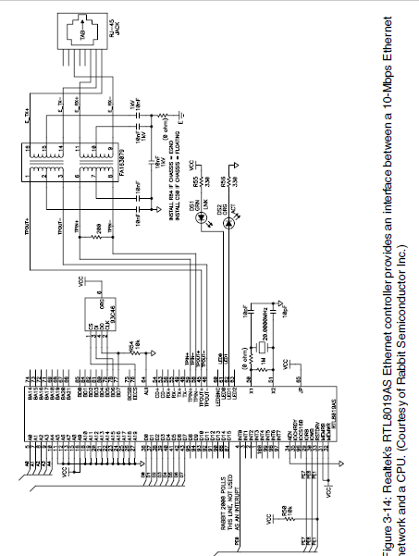

Slide 31
Data: A register bit selects whether the controller uses 8 or 16 data lines. Interrupts. An interrupt output can request service from the CPU. Three bits in the controller’s CONFIG1 register select one of eight interrupt outputs on the controller. On an ISA card, seven of these outputs each connect to one of the IRQ lines on the ISA bus. This enables a PC to configure the card to use an available IRQ line by writing the appropriate value to the register.

Slide 32
Serial EEPROM Interface. On power-up, the ’8019AS can be configured to retrieve information from a serial EEPROM or another component with a compatible interface. Pins BD5, BD6, and BD7 can function as the clock, data input, and data output for a Microwire synchronous serial interface.
These lines can connect to a 9346 serial EEPROM, which can store 1024 bits organized as 64 words of 16 bits each.
The ’8019AS has assigned EEPROM locations for initial values of configuration registers, an Ethernet address, and Plug and Play information.
Transferring Data
The ’8019AS manages network data much like the ’88796, using DMA to transfer data into and out of the SRAM and storing received data in a ring buffer.
Realtek also offers controllers that support Fast Ethernet and Gigabit Ethernet.

Slide 33
Using internet protocol in Local and Internet communications
The protocols in the IEEE 802.3 Ethernet standard enable the computers in a local network to exchange messages with each other.
Connecting to the Internet:
To communicate over the Internet, a computer must have three things: an
  IP address that identifies the computer on the Internet, the ability to send
  receive IP datagrams,
  a connection to a router that can access the Internet.
An Internet Service Provider (ISP) can provide one or more IP addresses and a connection to a router that can communicate over the Internet.

Slide 34
An Internet Service Provider (ISP) can provide one or more IP addresses and a connection to a router that can communicate over the Internet. Customers use a variety of ways to connect to ISPs.
Considerations in Obtaining Internet Service:
In many Internet communications, one computer functions as a client, and the other as a server.
  A client requests resources from a server.
  A resource may be a Web page, file, or other data.
  In response to a request, a server sends the client the requested resource or a response such as an error message.
Microsoft’s Internet Explorer and other Web browsers are clients. The text that you type or copy into the browser’s Address text box (such as http://www.Lvr.com or http://192.168.111.1) identifies the resource you’re requesting and the server you’re requesting it from.

Slide 35
To request webpages, download (or) upload 3 things
A) computer that functions as server
B) Internet account that permits hosting a server
C) network sequrity setting that enables server to receiver and responds to request from other computer
Technologies for Connecting
A long-popular way for home users to connect to the Internet is via dial-up connections on phone lines.
For higher speeds, alternatives are a Digital Subscriber Line (DSL), an Integrated Services Digital Network (ISDN) line, or a cable modem.

Slide 36
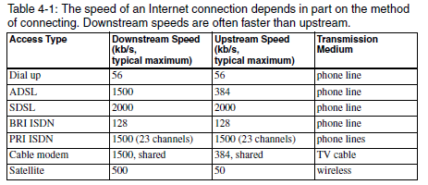

Slide 37
Dial Up
A dial-up connection is available anywhere there is phone service. A modem provides an interface between a computer that wants to access the Internet and an ordinary phone line.
To make a connection, the computer instructs the modem to dial a number that connects to a modem at the ISP. The ISP’s modem in turn connects to a router with an Internet connection.
A PC’s modem may be on the motherboard or an expansion card, or the modem may connect to the PC via an RS-232 or USB port.

Slide 38
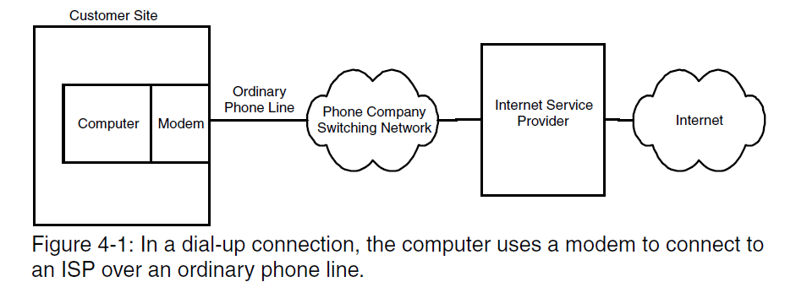

Slide 39
The computer uses the Point-to-Point Protocol (PPP) to manage the modem connection and to send and receive IP datagrams over the serial link. Rabbit Semiconductor’s Dynamic C has an optional module with libraries and example code for PPP communications.
For TINI users, the com.dalsemi.tininet.ppp package supports PPP. RFC 1661:
The Point-to-Point Protocol (PPP) defines the protocol.
Limitations of dial-up connections are a maximum speed of 56 kilobits per second and the need to provide a phone line for the connection

Slide 40
DSL(Digital Subscriber Line)
DSL uses a conventional phone line with equipment at each end to enable the line to carry voice and Internet communications at the same time.
a typical configuration, where the customer’s site has a DSL modem and a splitter.
In the upstream direction, a splitter combines phone and Internet traffic on a single pair of wires. In the downstream direction, the splitter routes the phone and Internet traffic onto the appropriate wires inside the customer’s premises.
Another name for the splitter is network interface device (NID).

Slide 41
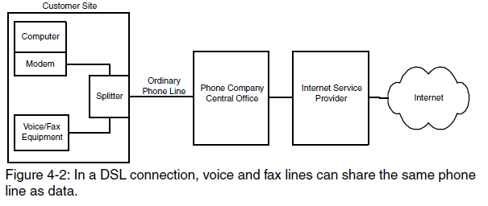

Slide 42
